Slide 1
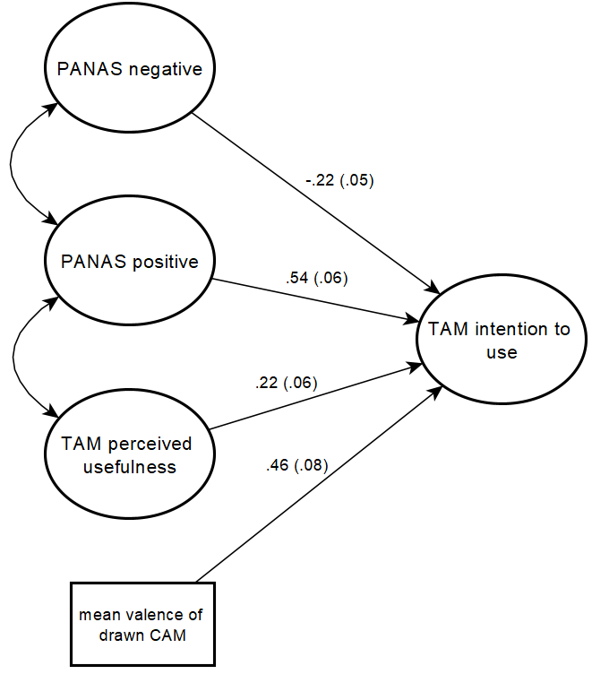
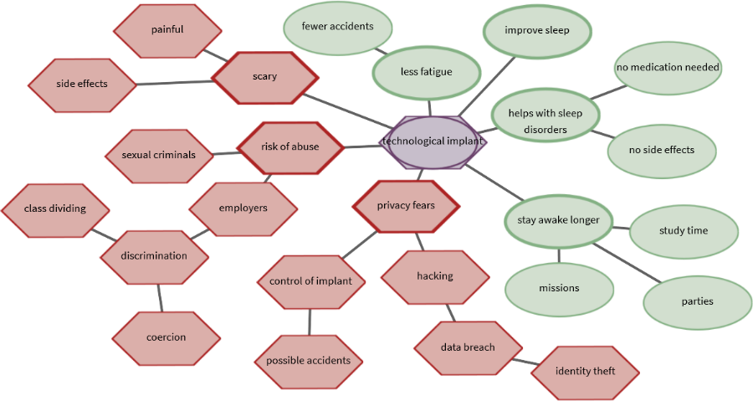

Predicting technology acceptance using CAMs
Use of a technology can be predicted according to the technology acceptance model (Venkatesh & Bala, 2008). Thereby, questionnaires assess previously known influencing variables. To identify further influential factors on technology acceptance so called "Cognitive Affective Maps" (CAMs) can be applied (e.g., Livanec et al., 2020). CAMs are a quantitative and qualitative research tool to identify, visually represent and analyze existing belief structures or attitudes.
Figure 1. CAM drew by a participant concerning the acceptance of a fictional nanoimplant.
Only recently have CAMs been increasingly researched quantitatively (e.g. Reuter et al. 2021), and currently I am working on an R package to quantitatively analyze these kinds of networks (e.g. aggregating CAMs, computing complex network indicators, splitting CAMs in components).
Pilot study
Can CAM data provide additional information to questionnaires and thus have an additional predictive value?
Participants (N=90) answered questionnaire scales and drew a CAM regarding a scenario text about the fictional nanoimplant.
Preliminary data analyses
Using structural equation models it is possible to structurally analyze the acceptance process of a fictional technology. To account for the non-normal distribution of the questionnaire items and the small sample, the DWLS estimator was used and the $X^{2}$ statistic adjusted (e.g., Hancock & Mueller, 2013). As a preliminary result, there is a highly significant influence of the mean valence of the drawn CAM on the intention to use the nanoimplant.
Figure 2. Predicting intention to use the nanoimplant.
Future Research Plans
Replicate the pilot study with sample size determined by a Monte Carlo study.
Systematically analyze CAM and questionnaire data for at least three studies (one dataset already collected) using different outcome variables and including additional structural network indicators.
Identifying clusters of similar CAMs using similarity algorithms and compare these clusters results with cluster results of questionnaire data
Hancock, G. R., & Mueller, R. O. (Eds.). (2013). Structural equation modeling: A second course. IAP.
Lischetzke, T., Reis, D., & Arndt, C. (2015). Data‐analytic strategies for examining the effectiveness of daily interventions. Journal of Occupational and Organizational Psychology, 88(3), 587-622.
Livanec S., Stumpf, M., Reuter L., Fenn J. & Kiesel A. (2021). Who’s gonna use this? Psychological acceptance prediction of emerging technologies and transdisciplinary considerations in the Anthropocene. Manuscript submitted for publication.
Reuter, L., Fenn, J., Bilo, T. A., Schulz, M., Weyland, A. L., Kiesel, A., & Thomaschke, R. (2021). Leisure walks modulate the cognitive and affective representation of the corona pandemic: Employing Cognitive‐Affective Maps within a randomized experimental design. Applied Psychology: Health and Well‐Being.
Venkatesh, V., & Bala, H. (2008). Technology acceptance model 3 and a research agenda on interventions. Decision Sciences, 39(2), 273-315.
Exploring cognitive affective maps as a new mode of data collection
Julius Fenn, University of Freiburg
Notes:
2-column design for graphic-heavy posters
Adjust font sizes to fit Title & Authors in one line each (but no smaller than 12pt!)
IMPORTANT: This template uses the font "Lora" for titles (it is also used in the SMiP logo). You can download (and then install) the font from
https://fonts.google.com/specimen/Lora
(it is licensed under the SIL Open Font License (cf. http://scripts.sil.org/OFL) which means you can use it freely (except for commercial purposes))

